Slide 1
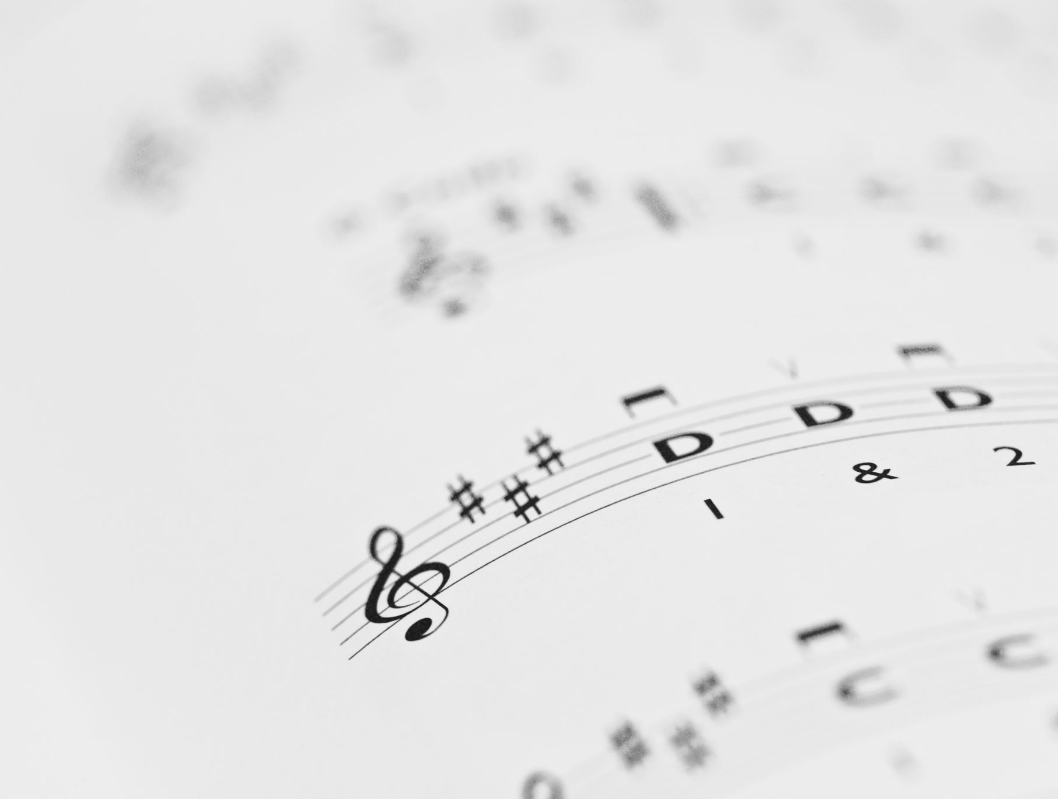
The Power of Lyrics
Analyzing the relationship between lyrical complexity and song popularity
Sarah Dias Barreto
Neha Chede
Angel George

Slide 2
Introduction: The Evolving Music Landscape
Rising Investments in Music
Annual surge of investments (~$4.1 billion) by record labels due to increased accessibility
Exponential growth in available music tracks demands efficient content retrieval methods
Music Information Retrieval (MIR)
Machine learning field analyzing music attributes (e.g., emotions, instruments, genres)
Enables predictions of songs with shared characteristics

Slide 3
Beyond Beats and Melody: The Need for Lyrical Analysis in Popularity Predictions
Past Research
Predicted music popularity using acoustic features, metadata, and temporal data
Classifiers such as Logistic Regression (LR) and Naive Bayes (NBC) demonstrated mixed performance
Studies achieved accuracy as high as 99% but lacked diverse performance metrics
Limitations
Minimal focus on correlating lyrical complexity with popularity and overemphasis on acoustic features, neglecting lyrical content
Research Gap
Focus on Lyrics - While musical features like melody, beat, and tempo are extensively studied, lyrical analysis remains underexplored
Hypothesis - Listeners may subconsciously prefer songs with emotionally engaging or complex lyrics, influencing engagement levels and repeat listens

Slide 4
Focus and Objective
Focus of this Study
Investigate whether lyrical complexity impacts song popularity on streaming platforms, with a focus on Spotify
Addresses a gap in research:
Prior studies explored the influence of genres, tempo, and artist popularity
Lyrical depth and listener engagement remain underexplored
Objective
Explore the relationship between lyrical complexity and song popularity across 60,000 Spotify songs

Slide 5
Data Description
Spotify’s Worldwide Daily Song Ranking Dataset
Daily rankings of the top 200 most-streamed songs in 53 countries
Covers data from January 1, 2017, to January 9, 2018
Over 3 million rows with about 6,629 artists and 19,923 songs totaling 178 billion streams
Metadata - song popularity metrics such as stream counts, user ratings, and listener engagement over time
Analyze song popularity trends globally and locally and capture metrics like stream counts, user ratings, and listener engagement over time
Song Lyrics Dataset
Includes lyrics of ~60,000 songs with metadata
Provides artist, song title, and hyperlinks to the original lyrics source
Perform text analysis on lyrics to explore their impact on song popularity and study linguistic and stylistic features in music trends

Slide 6
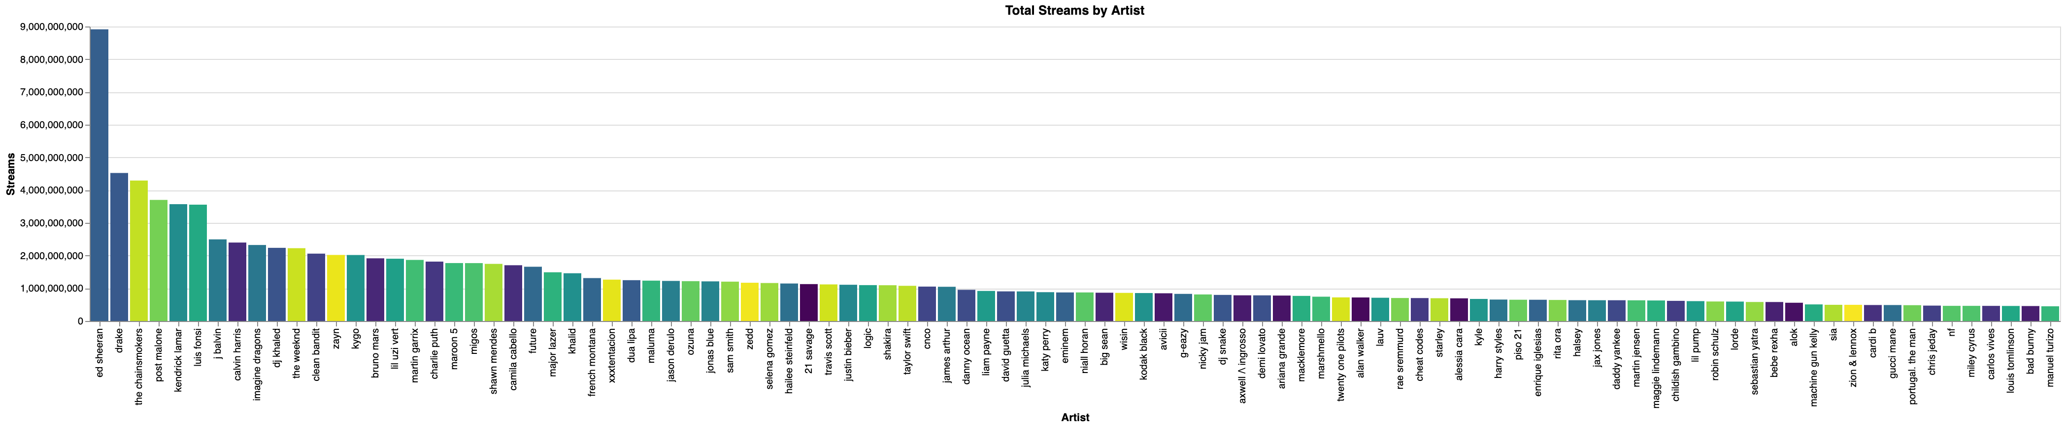
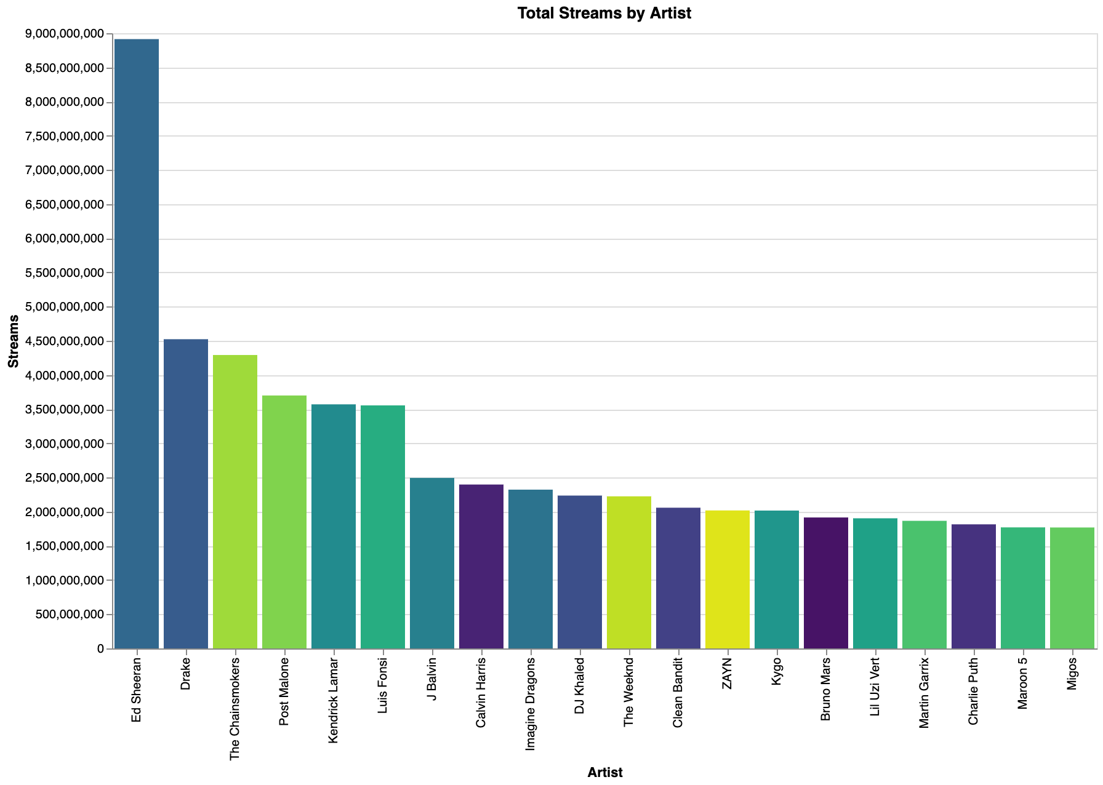
Stream Kings: Ed Sheeran Leads
Ed Sheeran leads in the artist category by a great margin of about 9 billion streams, followed by Drake and The Chainsmokers.
Notes:
There is a steep drop from the top-ranked to the others.
Group of mid-ranked artists clustered between 3 bill to 4 bill
The artists represent a variety of genres, including pop, hip-hop, EDM, and R&B.
The overall distribution suggests a logarithmic trend, where a few top artists dominate total streams, and the majority have considerably fewer streams.

Slide 7
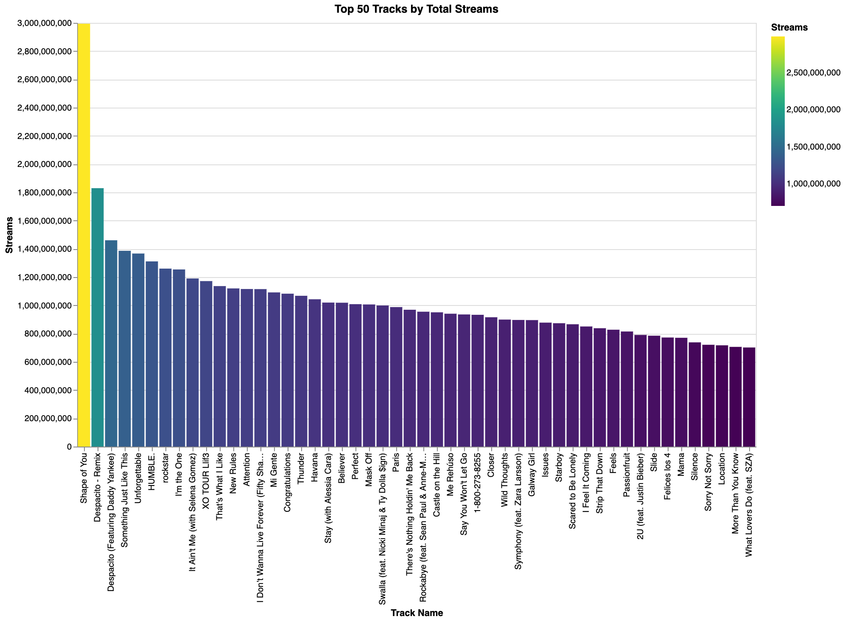
Top 50 Tracks by Total Streams: Dominance of 'Shape of You'
Shape of You leads in the tracks by total streams by a great margin of about 3 billion streams, followed by Despacito.

Slide 8
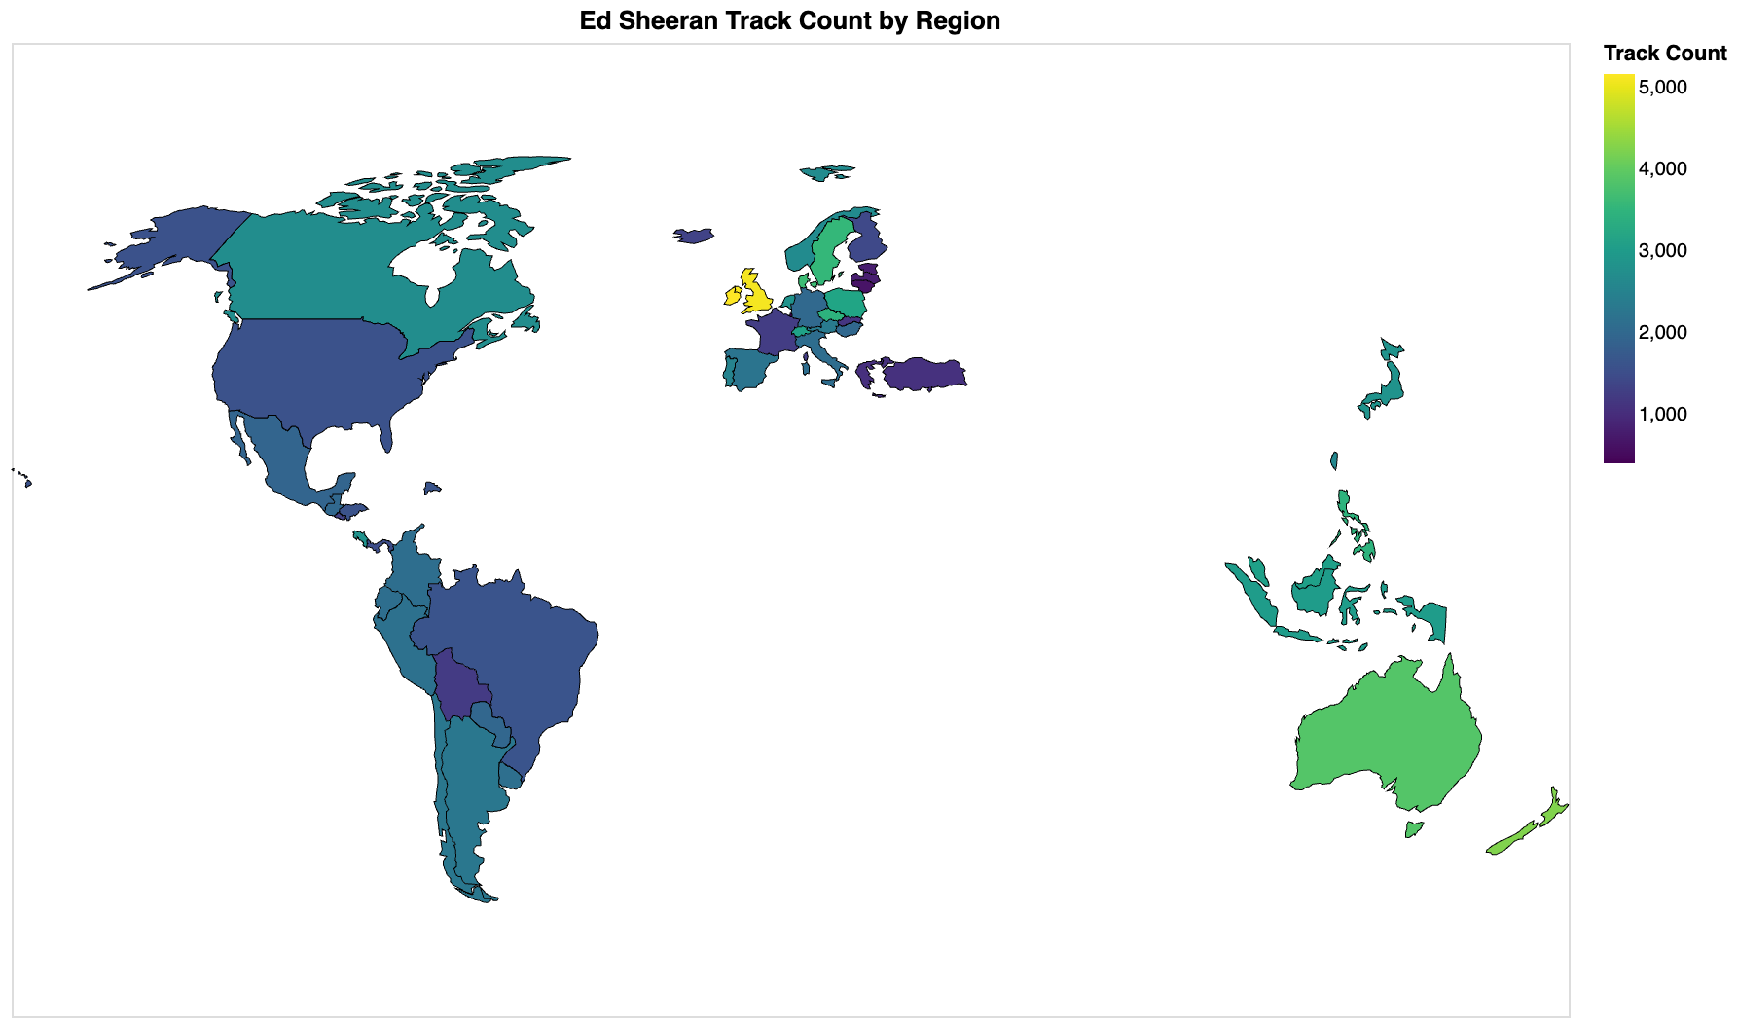
Ed Sheeran's Global Popularity: A Regional Breakdown
The map shows Ed Sheeran's global reach, with the UK - his home country - leading at 5,000+ tracks, followed by Australia, and New Zealand (4,000+). European countries like Germany and France follow, while emerging markets in South America, Asia, and Africa have fewer tracks, under 2,000.
Notes:
This strong presence in his home countries highlights the significant impact of local artists on their domestic music scenes.
Other English-speaking countries like the US, Canada, Australia, and New Zealand also have significant track counts, often exceeding 4,000. European countries like Germany, France, and the Netherlands follow, while emerging markets in South America, Asia, and Africa have a smaller but growing presence, with track counts often below 2,000. This highlights the global appeal of English-language music and Ed Sheeran's strong fan base, particularly in English-speaking nations.

Slide 9
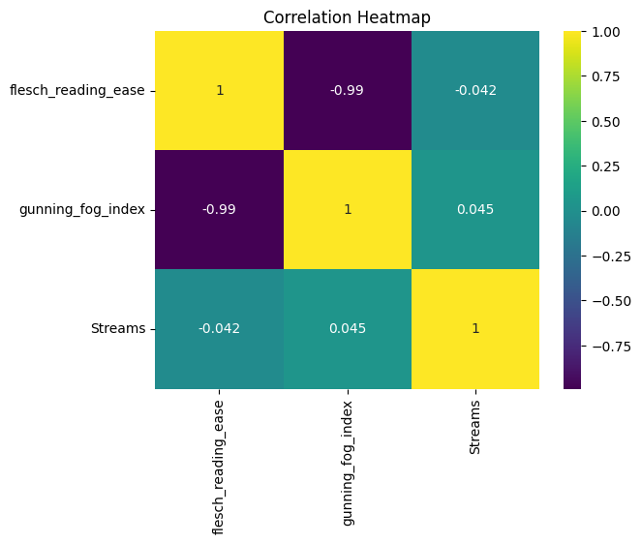
Correlation Analysis: Readability and Streams
 | Flesch Reading Ease | Streams
Flesch Reading Ease | 1.000000 | -0.042006
Streams | -0.042006 | 1.000000
The Flesch score indicates extreme difficulty, while the Gunning Fog index suggests extreme simplicity. This discrepancy might indicate an issue with the content's structure, such as fragmented text or inconsistent sentence complexity.

Slide 10
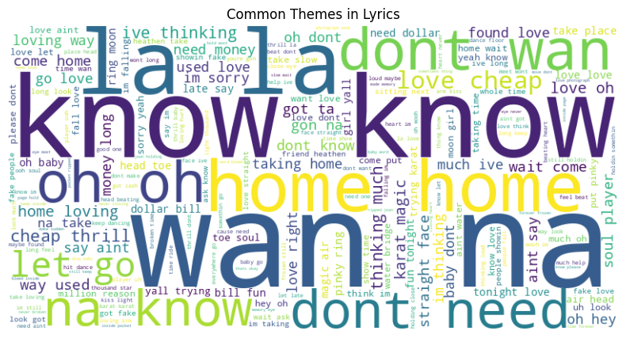
Word Cloud: Recurring Themes in Song Lyric
Prominent words like “home”, “know”, “love” suggests an emphasis on themes of emotional connection and belonging whereas informal words like “wanna” highlight conversational often used in popular music.

Slide 11
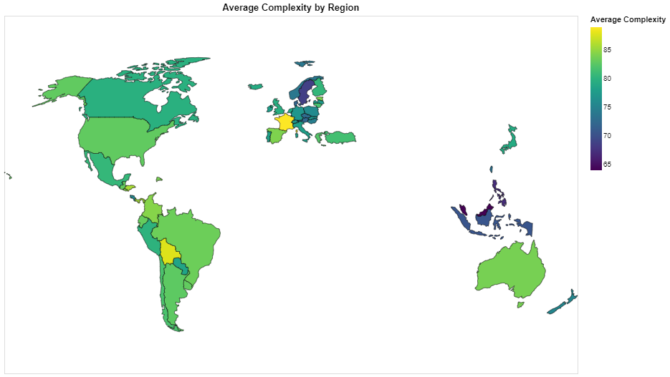
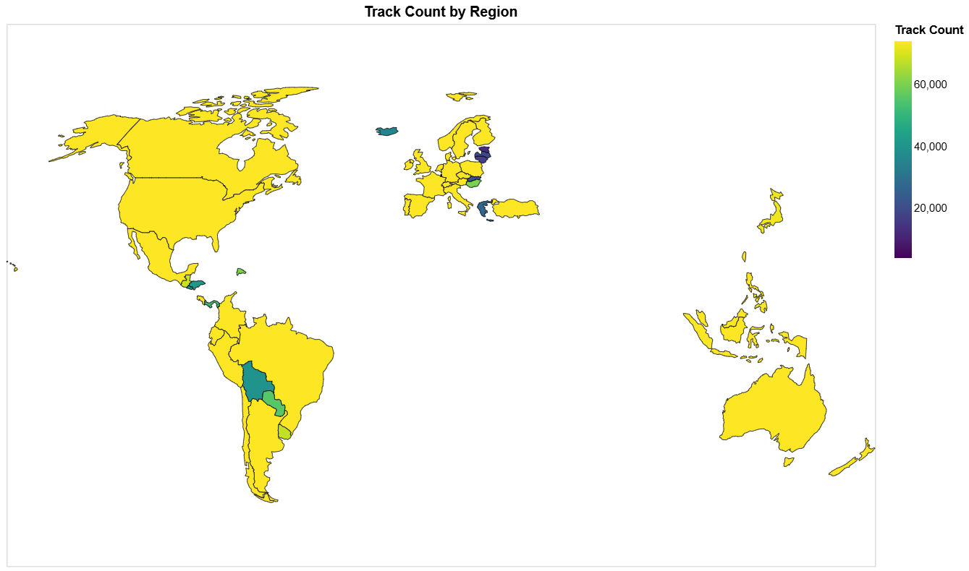
Choropleth
Track counts vary widely by region: the US leads with 80,000+ tracks, followed by Western Europe. Latvia and Lithuania have under 20,000 tracks, while emerging markets like Brazil and South Korea are growing.
European and Southeast Asian regions show higher lyrical complexity, favoring intricate songwriting, while the Americas have moderate to lower complexity, with simpler, more accessible lyrics common in popular genres.

Slide 12
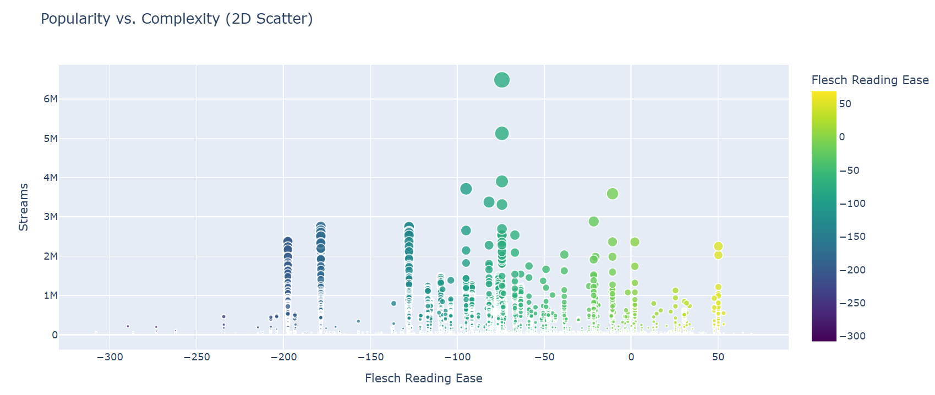
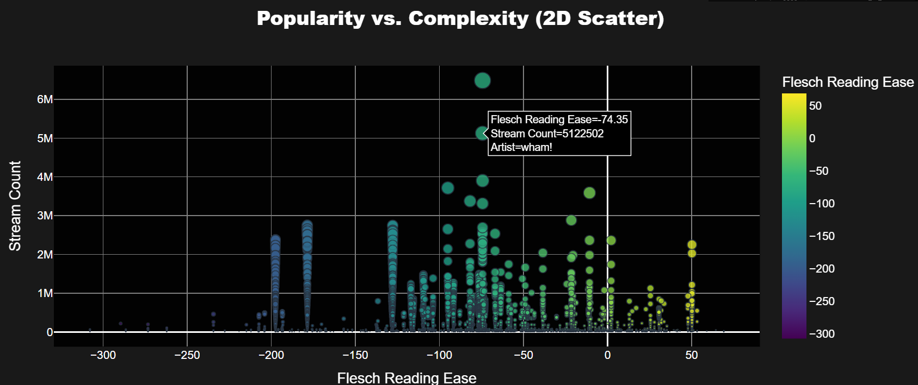
Scatterplots
Most streamed content correlates with moderately negative Flesch Reading Ease scores (-200 to -100), suggesting that content with a certain level of complexity might be more appealing or relatable to the audience.
Notes:
The dominance of negative Flesch scores (lower reading ease) indicates that audiences favor content with more intricate language or structure, possibly implying higher engagement with sophisticated lyrics or text.
Positive Flesch Reading Ease scores (simpler, more readable content) are rare and not strongly associated with high popularity. This suggests that overly simplistic text might lack the depth or appeal needed to generate significant interest.
Content with Flesch scores around -200 shows the widest variability in popularity, ranging from very low to extremely high streams. This indicates that moderate complexity can cater to diverse audience preferences.

Slide 13
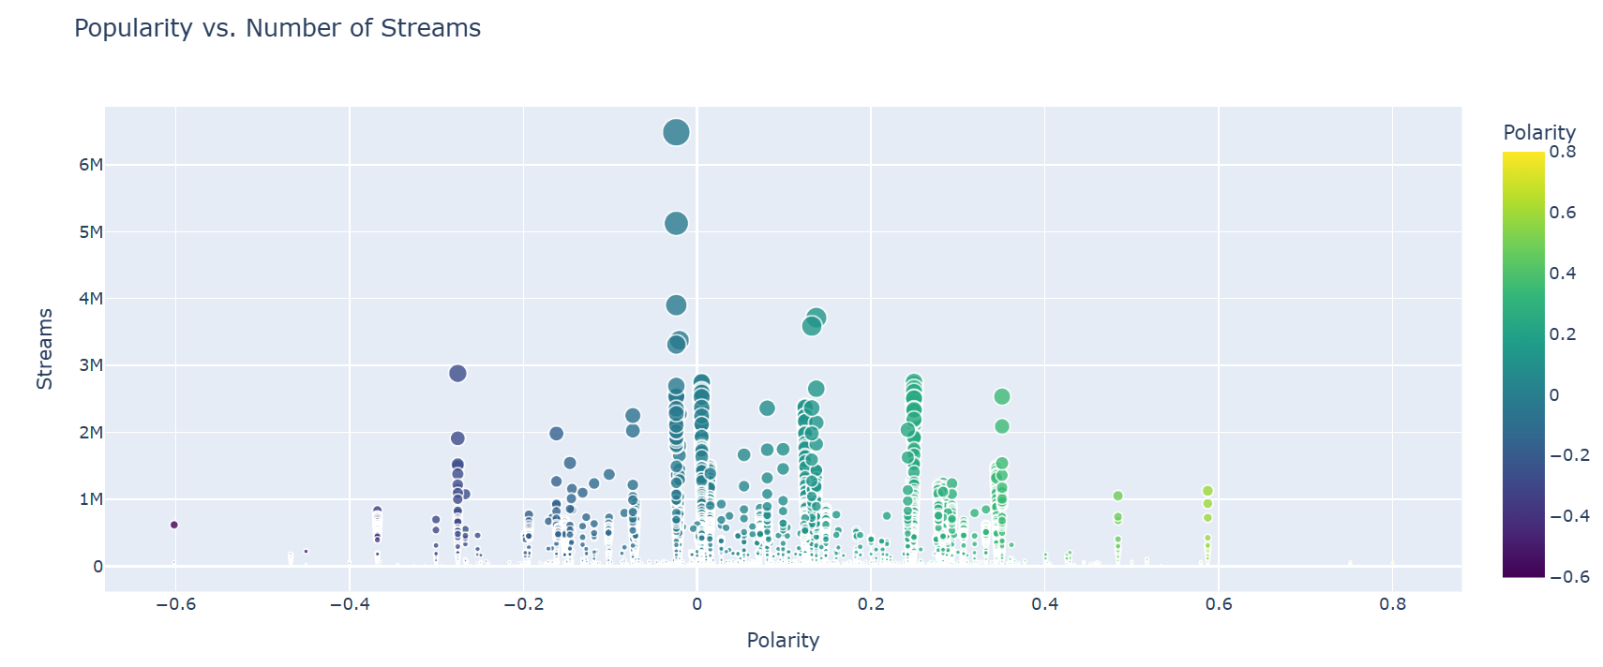
Scatter Plot Insights : Understanding Popularity Through Sentiment
Slightly negative sentiment (-0.3 to -0.1) and positive sentiment (0.1 to 0.3) drive high streams, as they strike a balance between emotional depth and relatability. Extreme sentiment (positive or negative) tends to lower popularity, possibly due to being too intense or niche.

Slide 14
Conclusion
Results
English-speaking countries dominate the music industry leading in track and stream counts.
Moderately complex and emotionally positive or negative lyrics resonate most with listeners.
Regional differences highlight cultural and linguistic diversity in music preferences.
Data limitations, such as missing genre classifications, impact analysis accuracy.
Future Scope
Use detailed datasets with genre and lyrical features like rhyme patterns.
Explore temporal trends and regional nuances in song preferences.
Investigate social media engagement to understand user listening habits
Deep dive into regional trends for specific regions like Latvia to understand local preferences and trends.

Slide 15
THANK YOU

